Slide 1

INTERNSHIP PROJECT REPORT
TITLE- AMAZON SALES ANALYSIS
NAME-sandhiya m
BATCH -1
www.sadhvisoft.com ©2023 Sadhvisoft Copyright

Slide 2
TABLE OF CONTENTS
1)INTRODUCTION
2)DETAILS OF DATA
3)TOOLS USED
4)MAIN KPI ‘S
5)SCREENSHOTS
6)MY DESIGN
7)CONCLUSION

Slide 3
INTRODUCTION:
Amazon.com, Inc. is an American multinational technology company that focuses on e-commerce, cloud computing, digital streaming, and artificial intelligence.
It is one of the Big Five companies in the U.S. information technology industry, along with Google, Apple, Microsoft, and Facebook.
The company has been referred to as "one of the most influential economic and cultural forces in the world," as well as the world's most valuable brand.

Slide 4
DETAILS OF DATA:
EDA PROJECTS WE WILL BE PERFORMING AMAZON SALES DATA ANALYSIS AND IT IS A INTERESTING DATASET TO WORK ON.
EXPLORE THE POPULARITY OF PRODUCTS BASED ON THE NUMBEROF USER REVIEWS AND RATINGS

Slide 5
TOOLS USED:
PANDAS
MATPLOTLIB
POWER BI

Slide 6
MAIN KPI’S USED:
TASKS:
IDENTIFY TOP 5 PRODUCTS BY RATINGS
ANALYSIS THE DISTRIBUTION OF DISCOUNT ANALYSIS BASED ON RATINGS.
IDENTIFY AVERAGING RATINGS FOR PRODUCTS IN MAIN CATEGORY.
IDENTIFY CATEGORY WISE SALES
IDENTIFY MOST DISCUSSED PRODUCTS BASED ON RATINGS

Slide 7
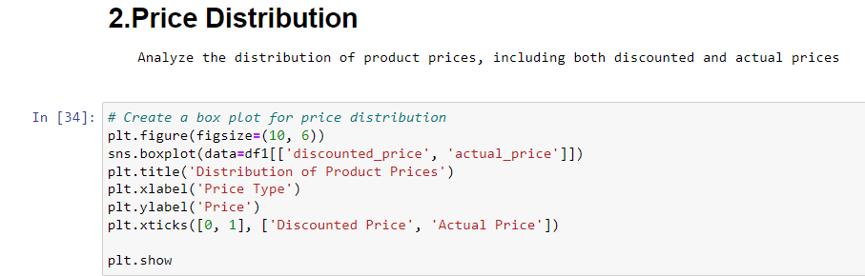
SCREENSHOTS:

Slide 8
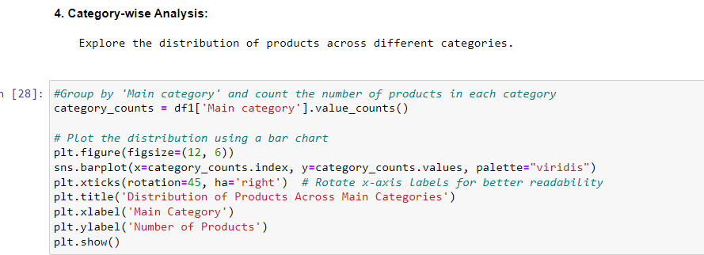

Slide 9
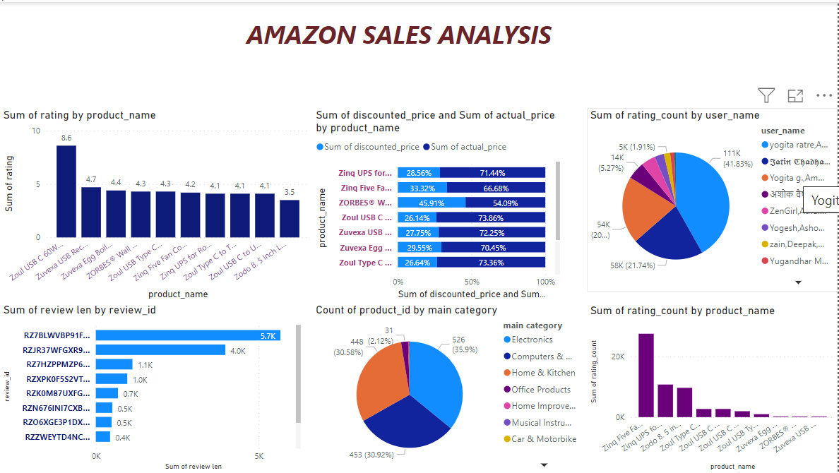
MY DESIGN:

Slide 10
CONCLUSION:
In conclusion, the methods employed in the data analysis of the given dataset were effective in providing insights into the data distribution.
The challenges encountered during the implementation of the methods provided valuable lessons for future works.

Slide 11
THANKYOU

